Slide 1
Li-fi technology
CREATED BY
DEBAYAN DE
SUMITRA CHOUDHUTY
KAUSHIK BISWAS

Slide 2
WHAT IS Li-fI
LI-FI OR LIGHT FILDEALITY IS A BIDIRECTIONAL ,HIGH SPEED AND FULLY NETWORKED WIRELESS COMMUNICATION TECHNOLOGY SIMILAR TO WI-FI, WHICH IS A FROM OF VISIBLE LIGHT COMMUNICATION AND A SUBSET OF OPTICAL WIRELESS COMMUNICATIONS(OWC)AND COULD BE A REPLACEMENT OF RF COMMUNICATION(WI-FI OR CELLULAR NETWORKS),OR EVEN A REPLACEMENT IN CONTEXTS OF DATA BROADCASTING
IT IS TRANSMISSION OF DATA THROUGH ILLUMINATION, i.e. SENDING DATA THROUGH A LED LIGHT BULB THAT VARIES IN INTENSITY FASTER THAN HUMAN EYE CAN FOLLOW

Slide 3
WHY LI-FI
CONGETION OF RADIO SPRECTRUM
DRAWBACKS OF RADIO SPRECTRUM
DISTANCE
COST
TRAFFIC UPDATES
GAME CONSOLES
TELEVISION INTERACTION

Slide 4
CONGESION OF RADIO SPRECTRUM
RADIO SPRECTRUM IS CONGESTED BUT THE DEMAND FOR WIRELESS DATA DOUBLE EACH YOER.EVERY THING, IT SEEMS WANT TO USE WIRELESS DATA BUT THE CAPACITY IS DRYING UP.

Slide 5
DRAWBACKS OF RADIO SPRECTRUM
UNCONTROLLED RADIATION:- UNUSEABLE IN THE AIRCRAFT,NEUCLEAR POWER PLANT,PERSON WITH PACEMAKER etc.
MORE LIGHTENING NEAR RF CELLULAR TOWER
IT ALSO AFFECTS SOME OF THE FRUITS GROWN NEAR THE RF TOWER AREA.
HACKING:-AS RF WAVES ARE AVALIABLE BOTH IN IOS AND NON IOS REGIONS OF TRANSMITTER, IT CAN BE EASILY INTRODUCED BY THE HACKERS AND CRUCIAL PERSONAL/OFFICIAL DATA CAN BE DECODED FOR MALICIOUS MOTIVES.
EFFICIENCY:-MILLIONS OF BASESTATIONS CONSUME HUGE AMOUNT OF ENERGY FOR TRANSMITTING THE RADIO WAVES ,TO COOL THE BASE STATION CABINS AND IT HAVE ONLY 5% EFFICIECY

Slide 6
HISTORY OF LI-FI
IT STARTED IN 1880 WHEN VISIBLE LIGHT COMMUNICATION(VLC)i.e. USE OF VISIBLE LIGHT PORTION OF ELECTROMAGNETIC SPRECTRUM USED TO TRANSMIT INFORMATION
THE TECHNOLOGY TRULY BEGAN DURING THE 1990’S IN COUNTRIES LIKE GERMANY,KOREA AND JAPAN WHERE THEY DISCOVERED LED’S COULD BE RETROFITTED TO SEND INFORMATION.PROF. HARALD HAAS COINED THE TERM ‘LI-FI’ AT HIS 2011 TED GLOBAL TALK HE INTRODUCED THE IDEA OF “WIRELES DATA FROM EVERY LIGHT”

Slide 7
ON 12th JULY 2011.HE USED A TABLE LAMP WITH AN LED BULB TO TRANSMIT A VIDEO OF BLOOMING FLOWERS THAT WAS THEN PROJECTED ONTO A SCREEN BEHIND HIM.DURING THE EVENT HE PERIODICALLY BLOCKED THE LIGHT FROM THE LAMP TO PROVE THAT THE LAMP WAS INDEED THE SOURCE OF INCOMING DATA.
AT TEDGlobal,HAAS DEMONSTRATED A DATA RATE OF TRANSMISSION OF AROUND 10Mbps –COMPARABLE TO A FAIRLY GOOD UK BROADBAND CONNECTION.TWO MONTHS LATER HE ACHIEVED 123 Mbps.
BACK IN 2011 GERMAN SCIENTISTS SUCCEEDED IN CREATING AN 800Mbps CAPABLE WIRELESS NETWORK BY USING LED LIGHTS.

Slide 8
WORKING PROCESS
OPERATIONAL PROCEDURE IS VERY SIMPLE, IF THE LED IS ON , YOU TRANSMIT A DIGITAL 1,IF IT IS OFF YOU TRANSMIT A 0.THE LED CAN BE SWITCHED ON AND OFF VERY QUICKLY,WHICH GIVES NICE OPPORTUNITIES FOR TRANSMITTING DATA.HENCE ALL THAT IS REQUIRED IS SOME LED’S AND A CONTROLLER THAT CODE DATA INTO THOSE LED’S.WE HAVE TO JUST VARY THE RATE AT WHICH THE LED’S.
FLICKER DEPENDING UPON THE DATA WE WANT TO ENCODE.
THUS EVERY LIGHT SOURCE WILL WORKS AS A HUB FOR DATA TRANSMISSION

Slide 9
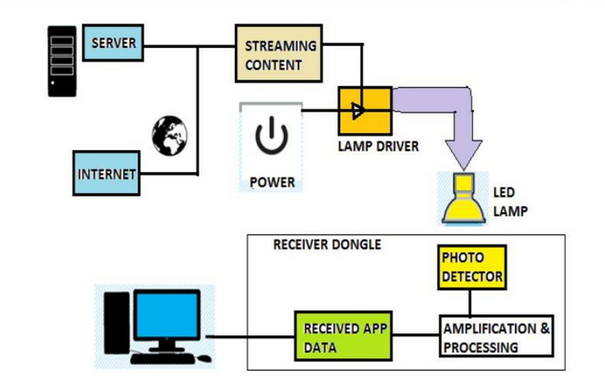
HOW LI-FI WORKS?

Slide 10
ON ONE END ALL THE DATA ON THE INTERNET WILL BE STREAMED TO A LAMP DRIVER WHEN THE LED IS TURNED ON THE MICROCHIP CONVERTS THE DIGITAL DATA IN THE FORM OF LIGHT
A LIGHT SENSITIVE DEVICE (PHOTO DETECTOR) RECEIVED THE SIGNAL AND CONVERTS IT BACK INTO ORIGINAL DATA. THIS METHOD OF USING RAPID PULSES OF LIGHT TO TRANSMIT INFORMATION WIRELESSLY IS TECHNICALLY REFERRED AS VISIBLE LIGHT COMMUNICATION

Slide 11
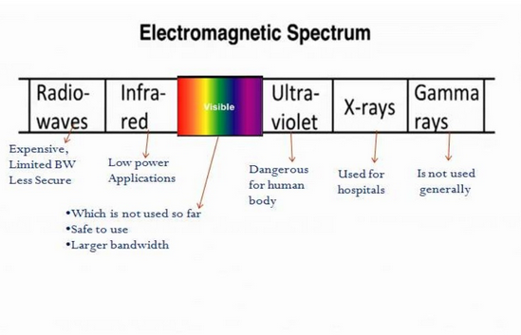
ELECTROMAGNETIC SPRECTRUM

Slide 12
WHY VLC
GAMA RAYS CANT BE USED AS THEY COULD BE DANGEROUS
X-RAY HAVE SIMILAR HEALTH ISSUES
ULTRAVIOLET LIGHT IS GOOD FOR PLACE WITHOUT PEOPLE, BUT OTHERWISE DANGEROUS FOR THE HUMAN BODY
INFRARED , DUE TO EYE SAFETY REGULATION, CAN ONLY BSE USED WITH LOW POWER

Slide 13
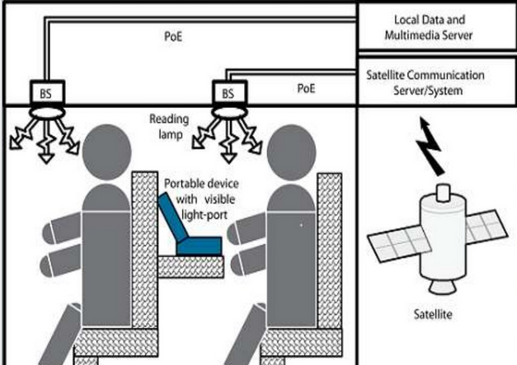

Slide 14
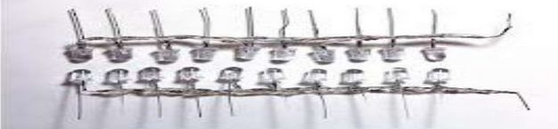
FURTHER ENHANCEMENTS CAN BE MADDE IN THIS METHOD , LIKE USING AN ARRAY OF LED’S FOR PARALLEL DATA TRANSMISSION, OR USING MIXTURES OF RED, GREEN AND BLUE LEDS TO ALTER THE LIGHT’S FREQUENCT WITH EACH FREQUENCY ENCODING A DIFFERENT DATA CHANNEL.SUCH ADVANCEMENTS PROMISE A THEORETICAL SPEED OF 10 Gbps – MEANING ONE CAN DOWNLOAD A FULL LENGTH HD FLIM IN JUST 30 SECONDS

Slide 15
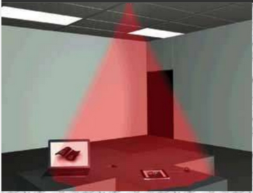
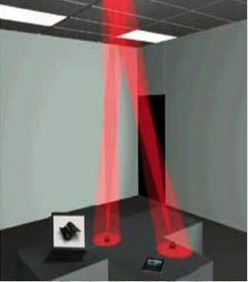
FOR GIGA SPEED TECHNOLOGIES, THE LIFI CONSORTIUM DEFINED GIGASHOWER, GIGASPOT AND GIGAMIMO MODELS.
GIGA SHOWER
GIGA MIMO

Slide 16
GIGASHOWER AND GIGAMIMO ARE THE OTHER MODELS FOR IN-HOUSE COMMUNICATION.THERE A TRANSMITTER OR RECEIVER IS MOUNTED INTO THE CEILING CONNECTED TO, FOR EXAMPLE, A MEDIA SERVER
GIGASHOWER PROVIDES UNIDIRECTIONAL DATA SERVICES VIA SEVERAL CHANNELS TO MULTIPLE USERS WITH GIGABITT-CLASS COMMUNICATION SPEED VOER SEVERAL METERS.IT IS LIKE WATCHING TV CHANNELS OR LISTENING TO DIFFERENT RADIO STATIONS WHERE TO UPLINK CHANNEL IS NEEDED. IN CASE GIGASHOWER IS USED TO SELL BOOKS, MUSIC, OR MOVIES, THE CONNECTED MEDIA SERVER CAN BE ACCESSED VIA Wi-Fi TO PROCESS PAYMENT VIA A MOOBILE DEVICE.GIGASPOT AND GIGAMIMO ARE OPTICAL WIRELESS SINGLE AND MULTI CHANNEL HOTSPOT CHANNELS OFFERING BIDIRECTIONAL GIGABIT CLASS COMMUNICATION IN A ROOM, HALL OR SHOPPING MALL FOR EXAMPLE.

Slide 17
LI-FI CONSTRUCTION
THE LI-FI PRODUCT CONSISTS OF 4 PRIMARY SUB-ASSSEMBLIES:-
BULB
RF POWER AMPLIFIER CIRCUIT(PA)
PRINTED CIRCUIT BOARD(PCB)
ENCLOSURE

Slide 18
THE PCB CONTROLS THE ELECTRICAL INPUTS AND OUTPUTS OF THE LAMP AND HOUSES THE MICROCONTROLLER USED TO MANAGE DIFFERENT LAMP FUNCTIONS.
AN RF(RADIO-FREQUENCY) SIGNAL IS GENERATED BY THE SOLID-STATE PA AND IS GUIDED INTO AN ELECTRIC FIELD ABOUT THE BLUB.THE HIGH CONCENTRATION OF ENERGY IN THE ELECTRIC FIELD VAPORIZES THE CONTENTS OF THE BULB TO A PLASMA STATE AT THE BULB’S CANTER ; THIS CONTROLLED PLASMA GENERATES AN INTENSE SOURCE OF LIGHT. ALL OF THESE SUBASSEMBLIES ARE CONTAINED IN AN ALUMINIUM ENCLOEURE
IN BULB ASSEMBLY A SEALED BULB IS EMBDED IN A DIELECTRIC MATERIAL , IT IS USED AS AN ELECTRIC FIELD CONCENTRATOR THAT FOCUS ENERGY IN THE BULB.THE ENERGY FROM E.F RAPIDLY HEATS THE MATERIAL IN THE BULB TO A PLASMA STATE THAT EMITS LIGHT OF HUGH INTENSITY AND FULL SPRECTRUM

Slide 19
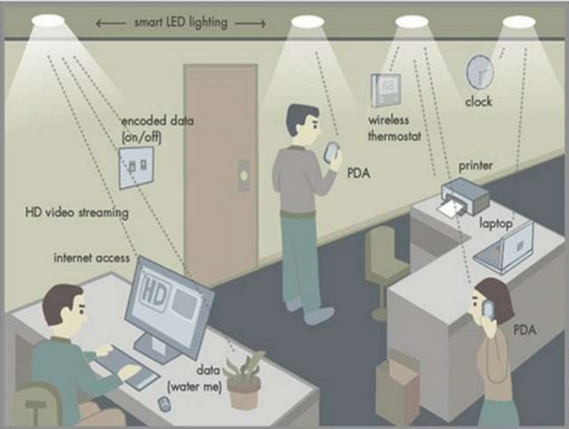

Slide 20
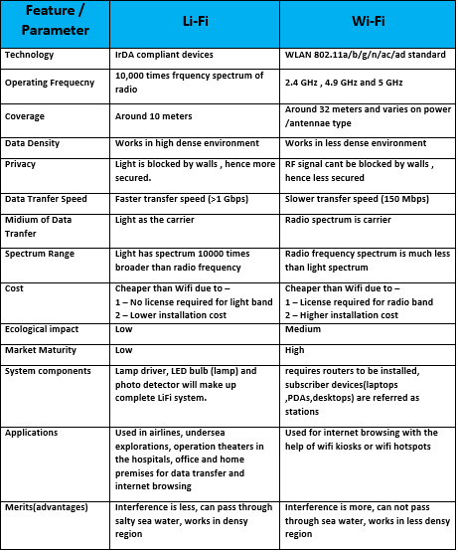
DIFFERENCE BETWEEN Wi-Fi and li-fi

Slide 21
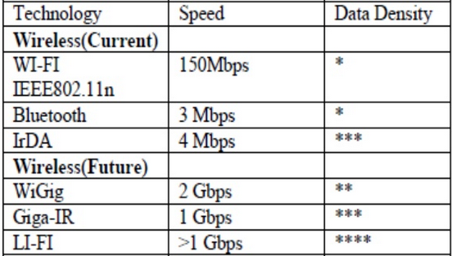
Comparison between current and future network technologies

Slide 22
LI-FI APPLICATIONS
SECURITY
UNDERWATER APPLICATION
HOSPITAL
VEHICLES

Slide 23
SECURITY
IN CONTRAST TO RADIO FREFUENCY WAVES USED BY WI-FI, LIGHTS CANNOT PENETRATE THROUGH WALLS AND DOORS.THIS MAKES IT MORE SECURE AND MAKES IT EASIER TO CONTROL WHO CAN CONNECT TO SOMEONE’S NETWORK.
AS LONG AS TRANSPARENT MATERIAL LIKE WINDOWS ARE COVERED, ACCESS TO A LI-FI CHANNEL IS LIMITED TO DEVICES INSIDE THE ROMM.

Slide 24
UNDERWATER APPLICATION
MOST REMOTELY UNDERWATER OPEATED VEHICLES(ROVS)USE CABLES TO TRANSMIT COMMAND,BUT LENGTH OF CAABLES THEN LIMITS THE AREA ROVS CAN DETECT.HOWWEVER AS A LIGHT WWAVE COLD TRAVEL THROUGH WATER, LI-FI COULD BE IMPLEMENTED ON VEHICLES TO RECEIVE AND SEND BACK SIGNALS
BUT THIS UTILITY IS LIMITED BY THE DISTANCE LIGHT CAN PENETRATE WATER.SIGNIFICANT AMOUNTS OF LIGHT DO NOT PENETRATE FURTHER THAN 200 METERS,PAST 1000 METERS , NO LIGHT PENETRATES.

Slide 25
HOSPITAL
MANY TREATMENS NOW INVOLVE MULTIPLE INDIVIDUALS. LI-FI SYSTEM COULD BE A BETTER SYSTEM TO TRANSMIT COMMUNICATION ABOUT THE INFORMATION OF PATIENTS.BESIDES PROVIDING A HIGHER SPEED.
LIGHT WAVES ALSO HAVE LITTLE EFFECT ON MEDICAL INSTRUMENTS AND HUMAN BODIES.

Slide 26
VEHICLES
VEHICLES COULD COMMUNICATE WITH ONE ANOTHER VIA FRONT AND BACK LIGHTS TO INCREASE ROAD SAFETY.
STREET LIGHT AND TRAFFIC LIGHT SIGNALS COULD ALSO PROVIDE INFI=ORMATION ABOUT CURRENT ROAD SITUATIONS.
EVERY STREET LIGHTS CAN BE USSED AS A NETWORK HUB.

Slide 27
Limitations of li-fi technology
INTERNET CANNOT BE USED WITHOUT A LIGHT SOURCE.THIS COULD LIMIT THE LOCATIONS WHERE LI-FI COULD BE USED.
BECAUSE IT SUES VISIBLE LIGHT, AND LIGHT CANNOT PENETRATE WALLS, THE SIGNAL’S RANGE IS LIMITED BY PHYSICAL BARRIERS.
OTHER SOURCES OF LIGHT MAY INTERFARE WITH THE SIGNAL.ONE OF THE BIGGEST POTENTIAL DRAWBACKS IS THE INTERCEPTION OF SIGNALS OUTDOORS.SUNLIGHT WILL INTERFARE THE SIGNALS, RESULTING IN INTERRUPTED INTERNET.
A WHOLE NEW INFRASTRUCTURE FOR LI-FI WOULD NEED TO BE CONSTRUCTED.

Slide 28
LI-FI IN THE PRESENT WORLD
PURELi-Fi DEMONSTRATED THE FIRST COMMERCIALLY AVALIABLE LI-FI SYSTEM, THE LI-1ST AT THE 2014 MOBILE WORLD CONGRESS IN BARCELONA.
BG-FI IS A LI-FI SYSTEM CONSISTING OF AN APPLICATION FOR A MOBILE DEVICE, AND A SIMPLE CONSUMER PRODUCT, LIKE AN iot (INTERNET OF THINGS)DEVICE, WITH COLOR SENSOR,MICROCONTROLLER, AND EMBDED SOFTWARE.LIGHT FROM THE MOBILE DEVICE DISPLAY COMMUNICATIONS TO THE COLOR SENSOR ON THE CONSUMER PRODUCT, WHICH CONVERTS THE TIGHT INTI DIGITAL INFORMATION.LIGHT EMITTING DIODES ENABLE THE CONSUMER PRODUCT TO COMMUNICATE SYNCHRONOUSLY WITH THE MOBILE DEVICE.
Philips lighting company has developed a VLC system for shoppers at stores. They have to download an app on their smartphone and then their smartphone works with the LEDs in the store. The LEDs can pinpoint where they are located in the store and give them corresponding coupons and information based on which aisle they are on and what they are looking at.

Slide 29
REFERENCES
https://en.wikipedia.org/wiki/Li-Fi
http://visiblelightcomm.com/5-reasons-to-promote-li-fi-technologies/
Li-Fi Technology for Indoor Access by Gado Mohamed Abd El-Moghith Doaa
INTERNATIONAL JOURNAL OF ADVANCES IN COMPUTING & COMMUNICATION, VOL1,2013,PAGE NO -12.WWW.IJACE.ORG

Slide 30

THANK YOU

